Slide 1

Client-Server
Architecture Overview
Presented by Furquan Ahmed

Slide 2
Introduction
Client-server architecture is a computing model that divides tasks between service requesters (clients) and service providers (servers). It is fundamental to network computing, enabling efficient data exchange and resource sharing across systems. Understanding this architecture is crucial for designing scalable and secure applications.

Slide 3

01
Basic Concepts of Client-Server Architecture

Slide 4
Definition and Purpose
Client-server architecture is a design model where clients request services and servers provide them. It allows centralized management of data, resources, and applications, making systems easier to maintain and scale. This model supports various services like web hosting, file sharing, and database access.

Slide 5

Components: Client, Server, Network
The architecture includes three main components: the client, which initiates requests; the server, which processes and responds; and the network facilitating communication. Each component plays a distinct role, ensuring reliability, responsiveness, and efficient resource utilization within the system.

Slide 6
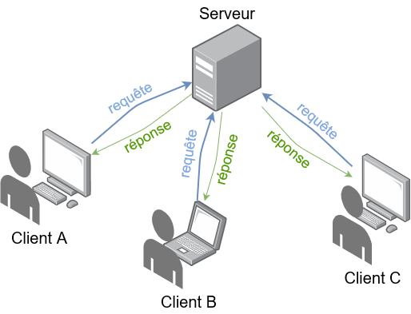
Interaction Model and Request-Response Cycle
In client-server architecture, the interaction model follows a request-response cycle. The client sends a request to the server, which processes it and returns the appropriate response. This cycle enables asynchronous communication and allows multiple clients to interact with a single server simultaneously, ensuring efficient resource sharing.

Slide 7
02
Design and Implementation

Slide 8
Types of Servers and Clients
Servers can be categorized by their purpose: web servers, database servers, file servers, and application servers. Clients vary from desktop applications to mobile devices and thin clients. Each type is designed to fulfill specific roles, optimizing resource use and user experience according to system requirements.

Slide 9

Communication Protocols (HTTP, TCP/IP)
Communication relies on protocols such as HTTP for web traffic and TCP/IP for reliable data transmission. These protocols define the rules for data exchange, ensuring secure, organized, and efficient communication between clients and servers across diverse networks.

Slide 10
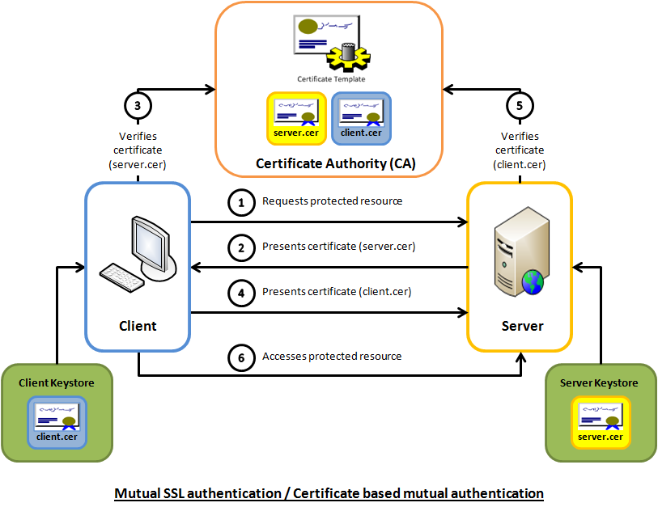
Scalability, Security, and Performance Considerations
Effective client-server systems must handle increasing loads through scalability options like load balancing and clustering. Security measures such as encryption and authentication protect data integrity. Performance optimization focuses on minimizing latency and maximizing throughput for seamless user experience.

Slide 11

Conclusions
Client-server architecture is essential for modern distributed computing, offering a clear framework for interaction, design, and implementation. Understanding its components, protocols, and operational considerations enables the development of robust, scalable, and secure systems aligned with business and technical needs.

